Slide 1



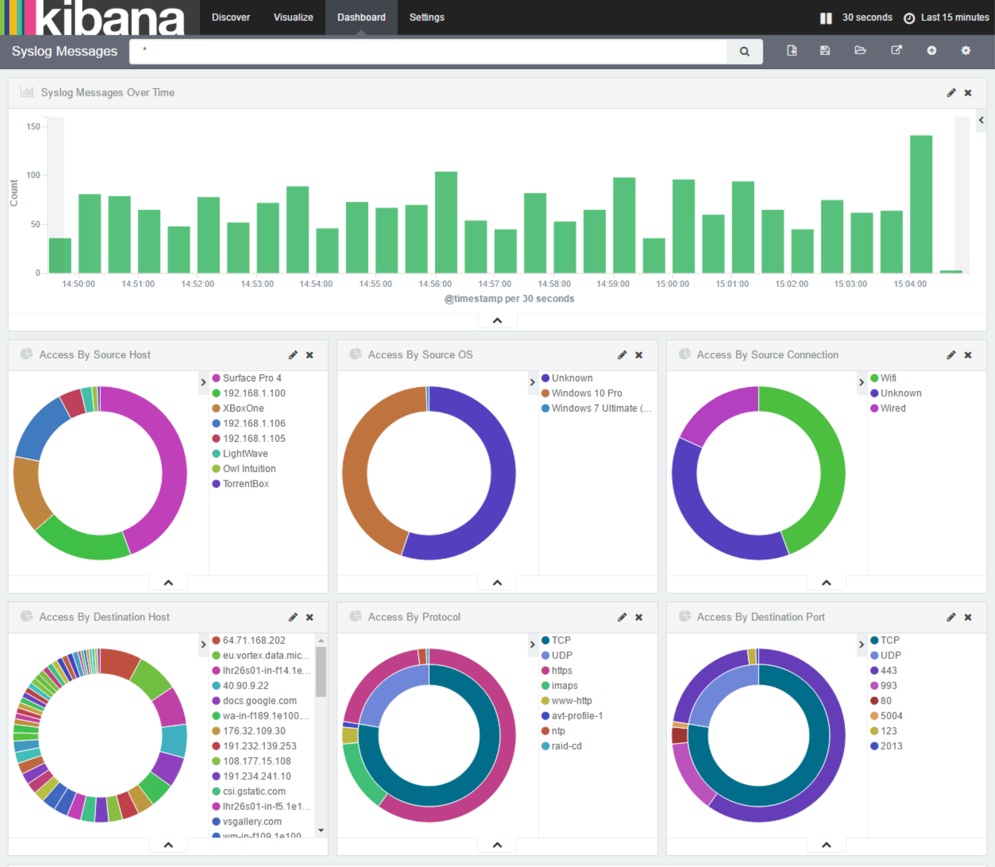
"Analyzing Key Factors Influencing Student Performance"
"Insights into Academic Achievement through Data on Attendance, Study Habits, and Demographics"

Slide 2
What is Tableau ?
Tableau is a powerful data visualization and business intelligence tool that allows users to connect to various data sources, create interactive and shareable dashboards, and generate insights from their data. It is widely used to transform raw data into visually appealing and easy-to-understand charts, graphs, maps, and reports
Data Connectivity: Tableau connects to a wide range of data sources, including databases, spreadsheets, cloud services, and big data platforms.
Drag-and-Drop Interface: Its user-friendly drag-and-drop interface makes it accessible to users without deep technical knowledge, allowing them to build visualizations quickly.
Real-Time Analysis: Tableau enables real-time data updates, making it possible to track trends and performance metrics as they happen.
Interactive Dashboards: Dashboards in Tableau are interactive, allowing users to filter, drill down, and explore data dynamically.
Collaboration and Sharing: Dashboards and reports can be shared online through Tableau Server, Tableau Cloud, or Tableau Public, fostering collaboration across teams.

Slide 3

Why we are making tableau dashboard ?
1. Data Visualization
5. Collaboration and Communication
2. Improved Decision-Making
6. Customizable and Scalable
3. Interactivity and Exploration
7. Insights from Complex Data
4. Efficiency and Time Savings

Slide 4
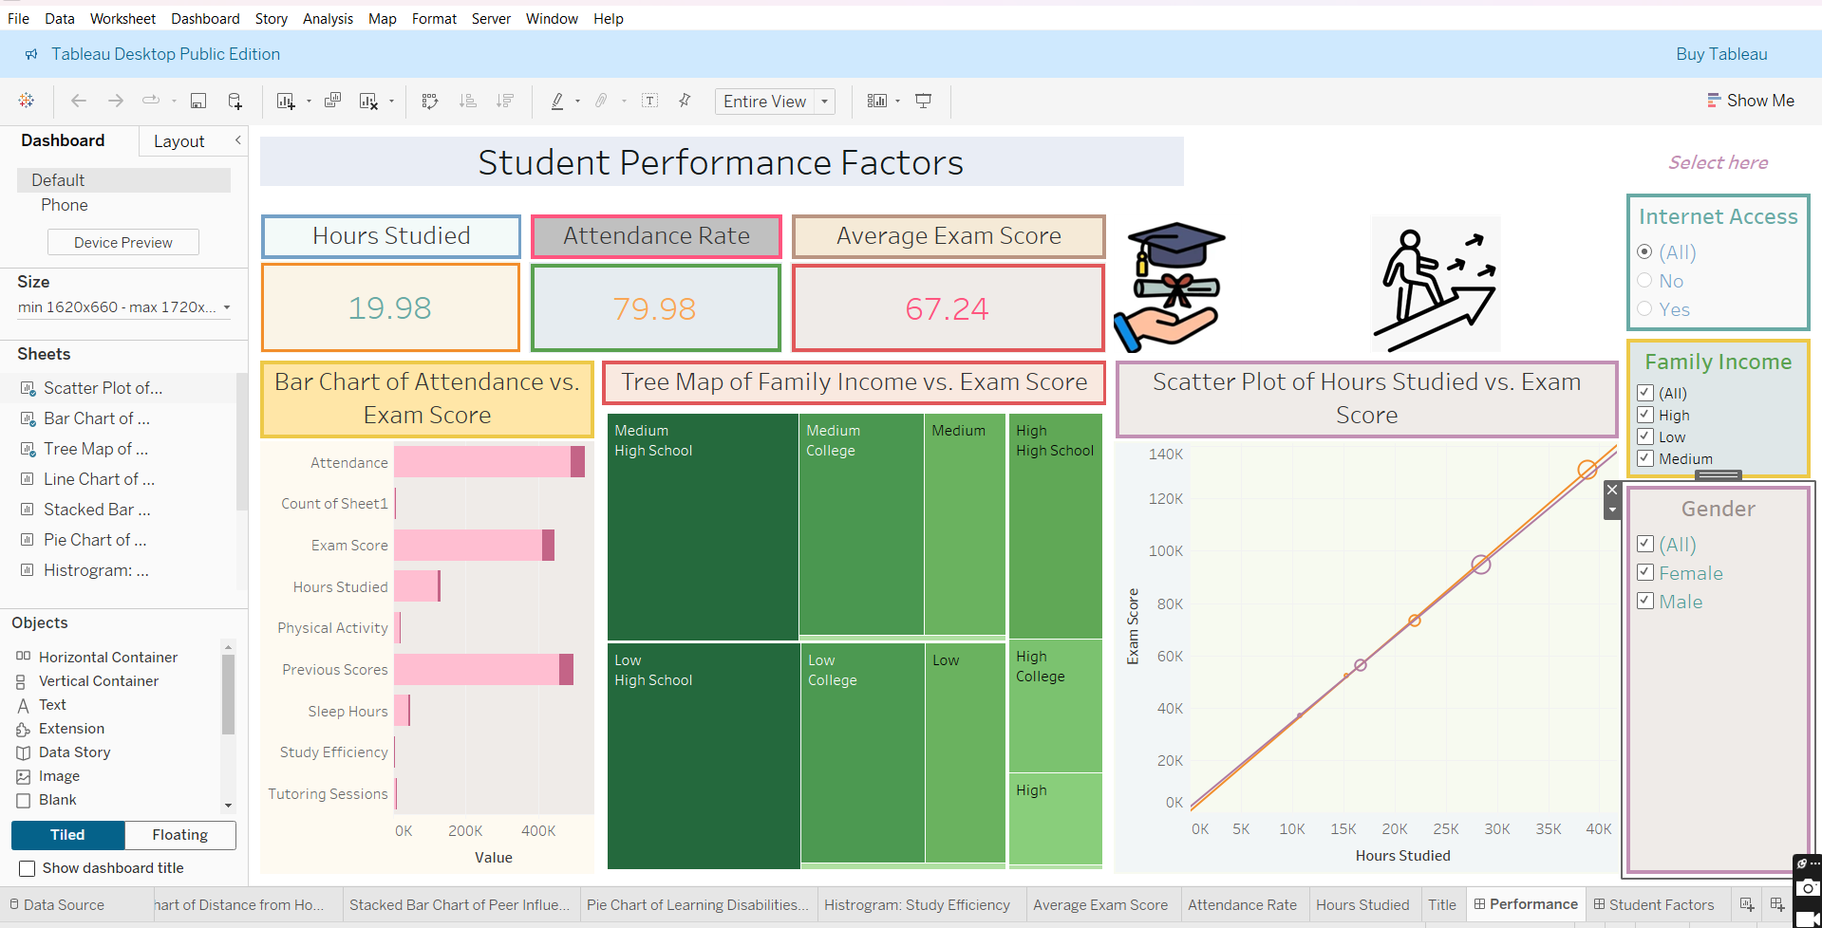
Tableau Dashboard

Slide 5
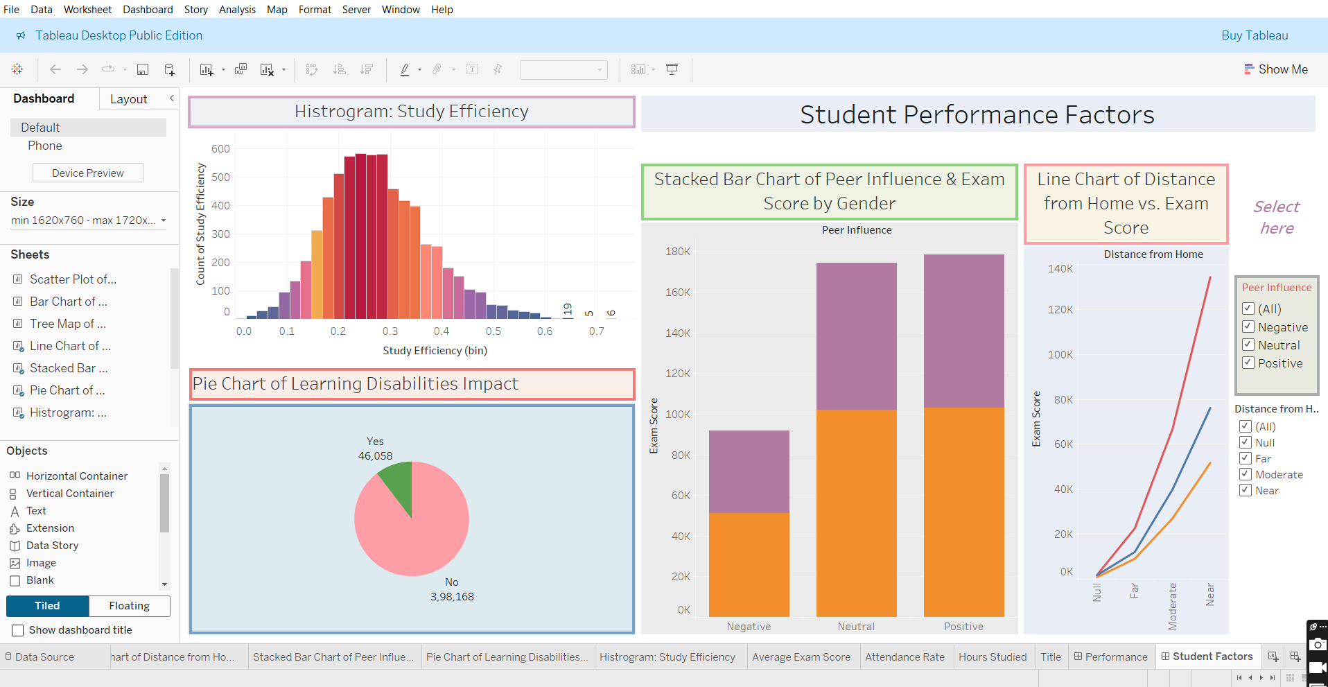
Tableau Dashboard

Slide 6
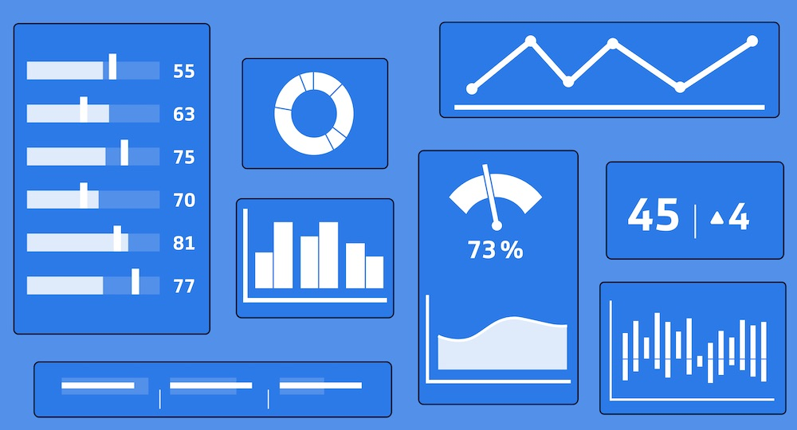
About Tableau Dashboard
Key Points on the Tableau Dashboard for Student Performance Factors:
Data Sources: Integrated student performance data, including grades, attendance, study hours, demographics, and extracurricular activities.
Visualizations:
Bar charts for academic performance across different subjects.
Line graphs for tracking attendance trends.
Scatter plots for correlation between study hours and performance.
Filters: Interactive filters for demographics (age, gender), academic year, and study habits for deeper insights.
KPIs: Displayed key performance metrics like average GPA, attendance rate, and study time per week.
Drill-Down Capabilities: Enabled users to explore performance based on specific subjects, classes, or demographic groups.
Insights: Highlighted the impact of attendance and study habits on student performance, with correlations visually represented.
Interactivity: Allowed users to filter and compare student performance across different factors in real-time.
User-Friendly Design: Simple, clean layout with color-coded visuals for easy interpretation of trends and relationships.

Slide 7
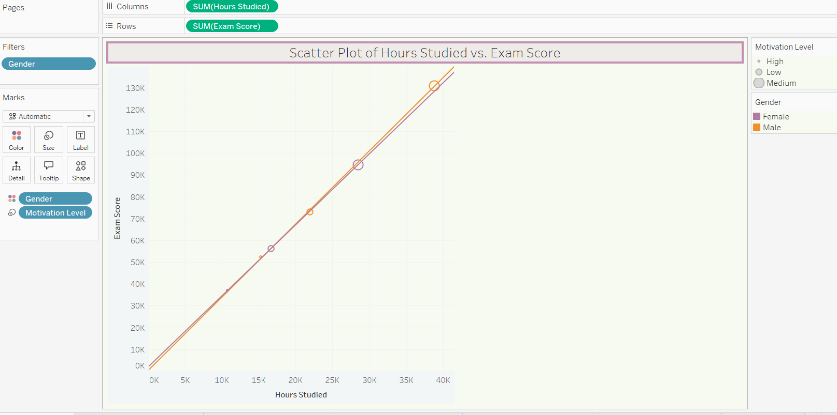
Scatter Plot chart
In this scatter plot, we visualized the relationship between the number of hours studied and the corresponding exam scores for students. Each data point represents a student's study hours
(plotted on the x-axis) and their exam score
(on the y-axis). Key features include:
Correlation Analysis: The plot helps identify the overall trend, showing whether more study hours correlate with higher exam scores.
Trendline: A regression line was added to highlight the general pattern and provide insight into the strength and direction of the relationship.
Interactivity: Filters allow users to view specific groups, such as by grade level, subject, or demographics, to explore how different factors might influence the correlation.
Outliers: Easily identifiable outliers, where students performed better or worse than expected based on their study hours.

Slide 8
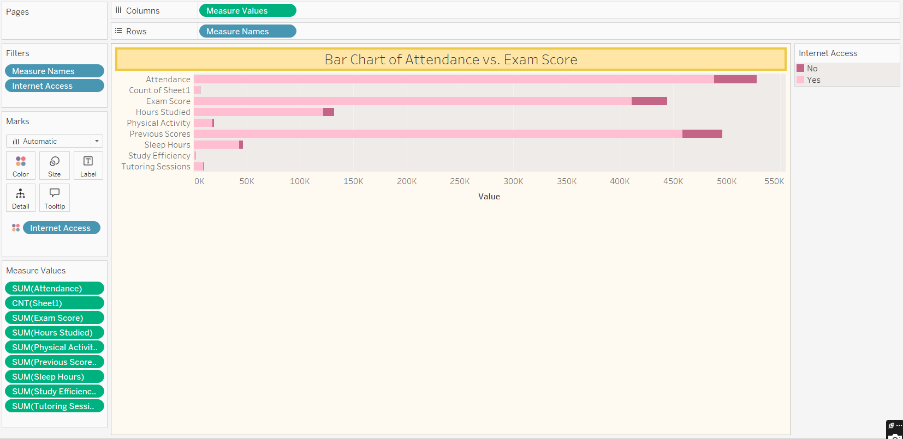

Bar chart
In this bar chart, we visualized the relationship
between student attendance and exam scores. The chart compares average exam scores across
different attendance levels. Key features include:
Grouped Bars:
Insights into Trends:
Color-Coding:
Interactivity:
This chart provides a straightforward view of how student attendance influences academic outcomes, emphasizing the importance of consistent class participation for better performance.

Slide 9
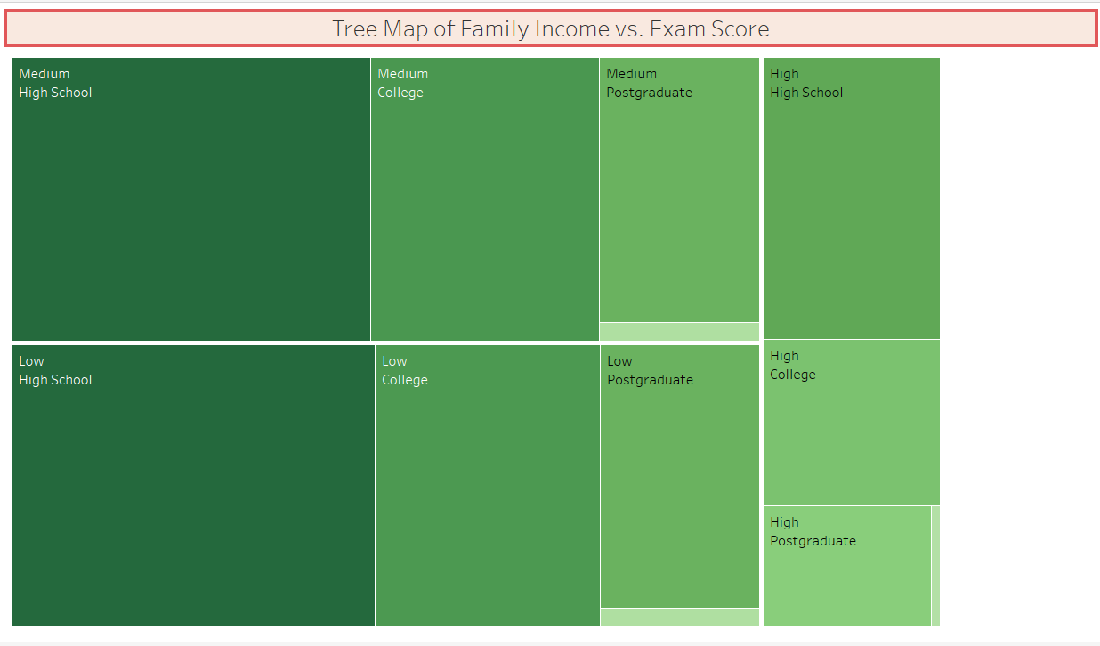
Tree Map
In this tree map, we visualized the relationship between family income levels (high, medium, low) and student exam scores. The chart represents the distribution of scores across different income groups. Key features include:
Income Categories: The tree map segments students into three categories based on family income (high, medium, low).
Block Sizes: Each block represents the number of students within an income category, with larger blocks indicating a higher number of students.
Color Shading: The intensity of color within each block reflects average exam scores, with darker shades representing higher performance and lighter shades showing lower scores.
Comparison Across Income Levels: The tree map allows for easy comparison of exam performance between students from different income backgrounds.
Interactivity: Filters enable users to explore how other factors like subject or grade level influence the relationship between income and exam scores.

Slide 10
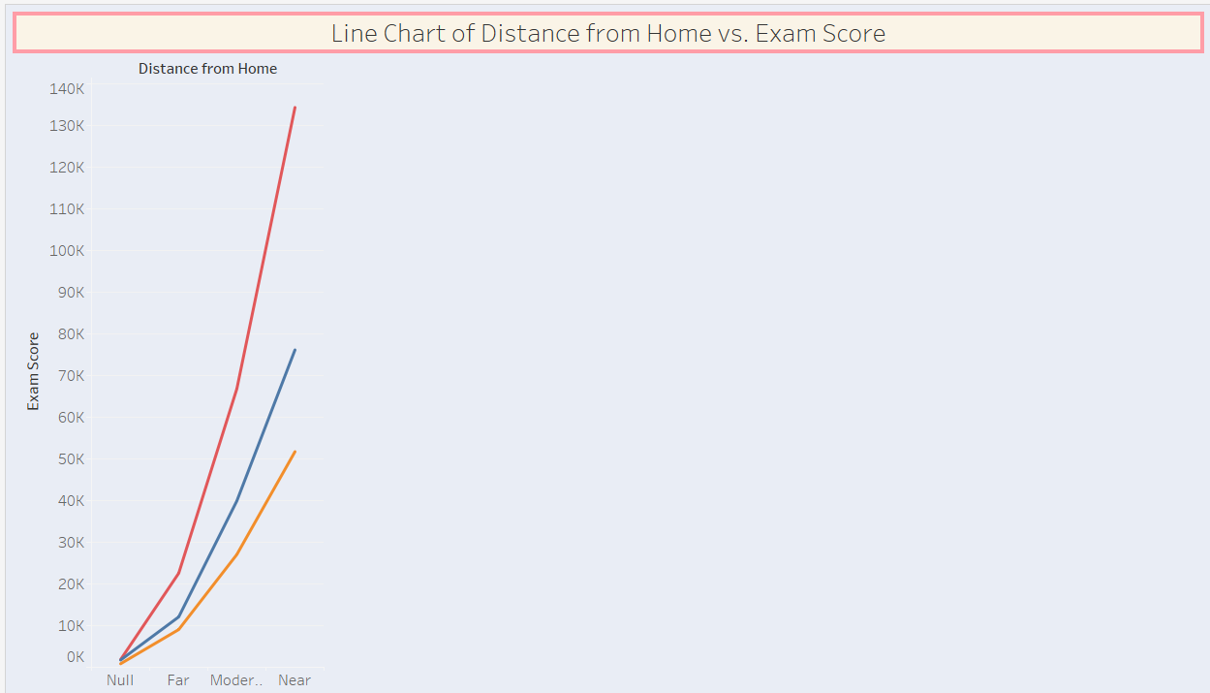
Line Chart
In this line chart, we visualized the relationship between the distance students live from school and their exam scores. The chart helps to analyze how commuting distance might influence academic performance.
This line chart offers insights into how the physical distance between home and school impacts student performance, aiding in discussions about transportation challenges and their effects on academic success.

Slide 11
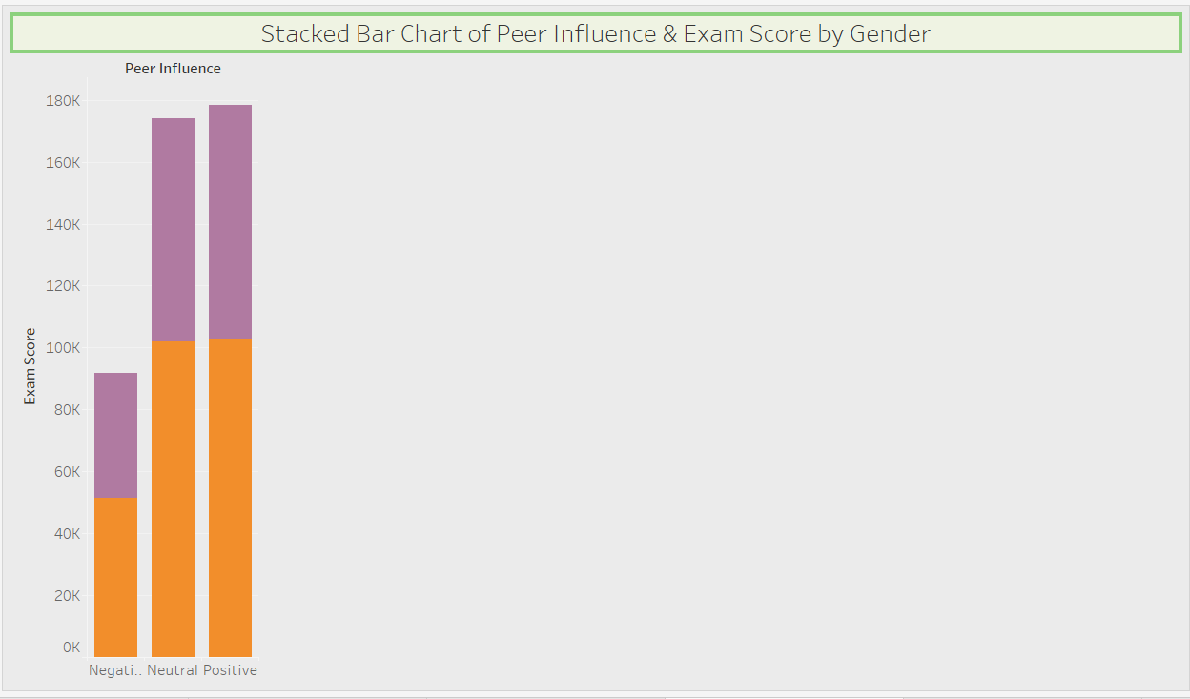
Stacked Bar Chart
In this stacked bar chart, we visualized the impact of peer influence (categorized as positive, neutral, and negative) on exam scores, differentiated by gender. Key features include:
Categories: Each bar represents a gender (e.g., male and female) and is divided into three segments for peer influence types: positive, neutral, and negative.
Score Representation: The height of each segment indicates the average exam score associated with each type of peer influence, allowing for easy comparison between genders.
Comparison of Influence Types: The chart highlights how different types of peer influence affect academic performance for males and females, showcasing any disparities.
Color Coding: Each influence category is color-coded, enhancing visual clarity and making it easy to differentiate between positive, neutral, and negative influences.

Slide 12
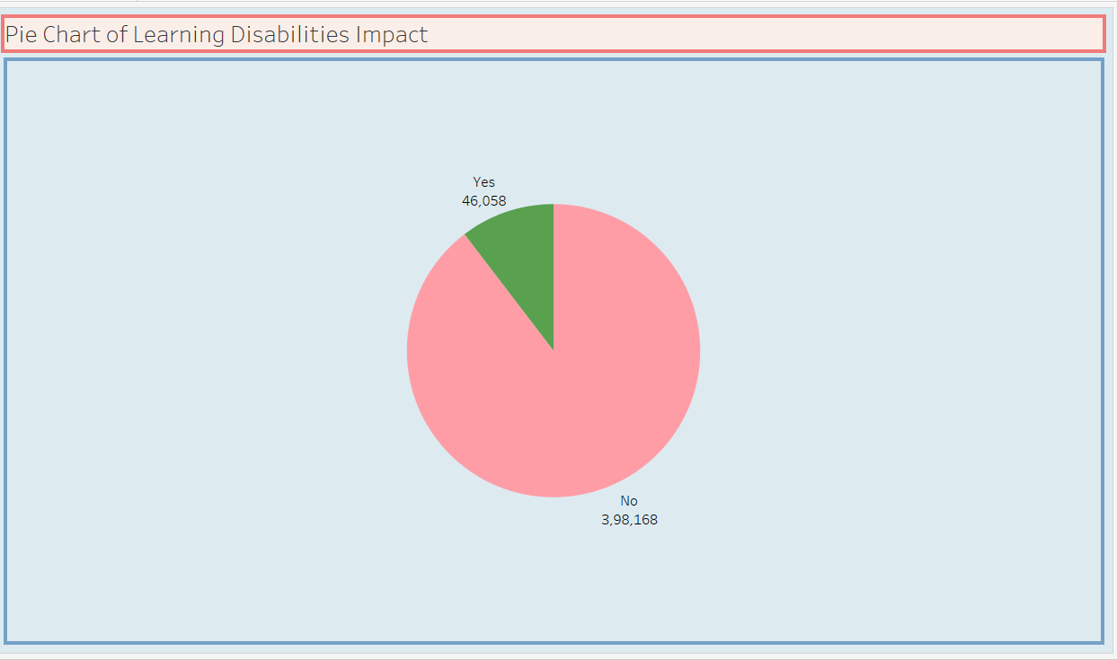
Pie Chart
In this pie chart, we visualized the distribution of different types of learning disabilities among students. Key features include:
Categories Represented: Each slice of the pie corresponds to a specific learning disability (e.g., dyslexia, ADHD, dyscalculia, etc.), showing the proportion of students diagnosed with each type.
Visual Representation: The size of each slice indicates the percentage of the total student population affected by each learning disability, making it easy to see which disabilities are most and least common.
Color Coding: Different colors are used for each disability type, enhancing clarity and making it visually appealing.
Data Labels: Percentage labels on each slice provide quick insights into the prevalence of each condition, allowing for immediate understanding of the distribution.

Slide 13
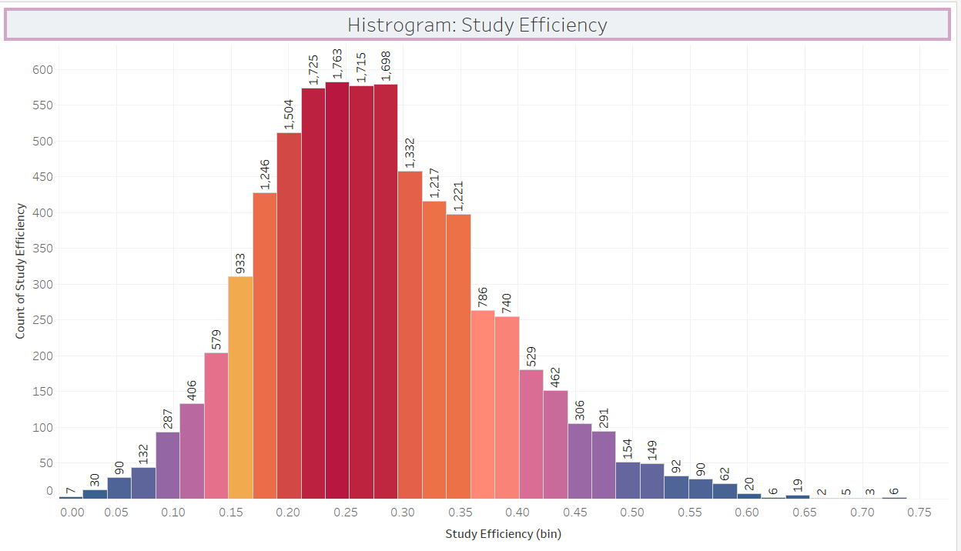
Histrogram
In this histogram, we visualized the distribution of study efficiency among students. Key features include:
Bins Representation: The x-axis represents ranges of study efficiency scores, while the y-axis indicates the number of students falling within each range.
Frequency Distribution: Each bar shows how many students achieved efficiency scores within specified intervals, allowing for easy identification of common performance levels.
Trend Analysis: The shape of the histogram reveals trends in study efficiency, such as whether most students fall into low, medium, or high efficiency categories.
Color Coding: Different colors may be used to enhance readability and highlight specific ranges of study efficiency.

Slide 14
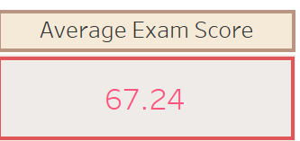
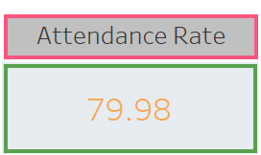
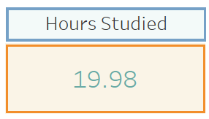
Creating Key Performance Indicators (KPIs)
KPI 1: Average Exam Score
KPI 2: Attendance Rate
KPI 3: Hours Studied

Slide 15

This Photo by Unknown Author is licensed under CC BY-SA

